Slide 1
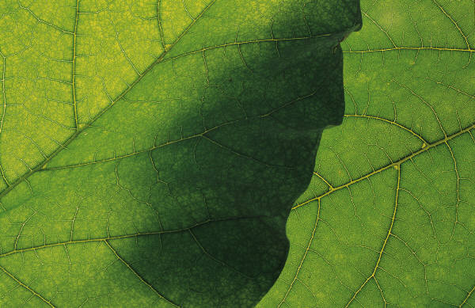
Botanicals for children
A toolkit of safe & effective options
Katie Wahl, RN, BSN
DNP Student: Pediatric Nurse Practitioner Specialty

Slide 2
Presentation goals
Explain unique safety considerations for pediatric population
Provide clinician’s with a toolkit of safe botanicals to use with the pediatric population
Discuss botanicals to be avoided in the pediatric population

Slide 3

Background on pediatrics
Few clinical trial and systematic reviews for pediatric use of botanicals (Gardiner & Low Dog, 2010)
Children are not “little adults”
Different metabolism and drug clearance
At higher risk for adverse reactions from contaminants/misidentified herbs (Ernst, 2003)
Lead, mercury, cadmium
Neurologic and gastrointestinal effects

Slide 4
What can we do?
Instruct families to look for GMP labels
Remind that botanicals regulated by DSHEA, not FDA
Safety and efficacy not evaluated prior to marketing
Claims are non-specific and not required to be backed by clinical trials
Call MedWatch and Poison Control (800-222-1222) with concerns of adverse effects related to botanicals
Gardiner & Low Dog, 2010
Notes:
Look for good manufacturing practices labels : endorsed by FDA, produced in a quality manner without contaminents, impurities, are accurately labeled. Addresses concerns for contaminents.
Then remind families botanicals not regulated by FDA for safety… regulated by DSHEA : dietary supplement and health education act. Marketed without approval or evaluation of efficacy and safety by FDA … need not be any clinical trials for nonspecific health claims like “enhances gut health of baby”
Report

Slide 5
Clinical Relevance
Parents often wish to avoid use of medications for their children
May look to botanicals and assume they are a safe and non-potent alternative
Need to be aware of which botanicals are safe options and counsel families
Gardiner & Low Dog, 2010
Notes:
Potential for benefit and for harm

Slide 6

Talking with families about botanicals
Need to ask what they are currently using without judgment
“Do you use herbal remedies with your children?”
“What are you trying to treat and do you think the herbs are working?”

Slide 7
Talking with families cont.
Influences of botanical use
Cultural/folk medicine history in family
Dissatisfaction with conventional approaches
Unlikely to be getting information from medical providers
Friends, family, internet

Slide 8
Herbs to avoid in children
Mistletoe, lobelia, digitalis, ephedra, pennyroyal essential oil
Chronic use of: licorice, comfrey, chaparral
Renal, hepatic, electrolyte abnormalities
Tea tree oil
Can cause unconsciousness in children if ingested

Slide 9
Populations to avoid botanicals in
Complex conditions
Cardiac, asthma
On multiple pharmaceutical medications or medications with narrow therapeutic window
Digoxin
Anti-epileptic drugs
Severe/significant illness or symptomatology

Slide 10
German Chamomile Matricaria recutita
Anti-spasmodic, anti-inflammatory, nervine actions
Calming and relaxing
Good safety profile (Gardiner & Low Dong, 2010)
Flowers
Use as nervine relaxant
Mild and gentile calming
Avoid with daisy allergies
1-3 grams flowers steeped in hot water for 10 minutes
3-4 cups a day okay
Taylor, 2017b

Slide 11
Chamomile for colic
Chamomile in combination with fennel and lemon balm is effective at treating colic (Savino, Cresi, Castagno, Silvestro, & Oggero, 2005)
RCT, double-blinded study compared a mixture with those botanicals with placebo for efficacy and side effects
Population: breastfed infants with colic
Colic: Wessel’s critera
Mixture given 2x/day 5pm and 8pm just before feeds for 7 days
Dose 2mL/kg/dose
Significant improvements in crying time for treatment group 85.4% had reductions, compared to 48.9%
Notes:
His definition of a colicky infant was a child who cried for more than 3 hours a day, for more than 3 days a week, for over 3 weeks. This is often referred to as the “Rule of 3’s” and these rules came to be known as the Wessell Criteria, which is now used in most current studies of babies with colic.
Important to use extracts rather than a cup of chamomile tea because don’t want to displace the nutrition and intake of breastmilk
Criticism is finding this botanical for use in peds for purchase… gripe water is commonly chosen but has fennel and ginger. Then gerber colic treatment has lactobacillus colonies in it.

Slide 12
Chamomile for Diarrhea
When combined with pectin helpful for diarrhea (De La Motte, et al., 1997).
Double-blind RCT
Population 6 months- 5.5 years
Receive either apple pectin + chamomile product vs. placebo for diarrhea combined with usual rehydration care
Results
More likely to have stopped by 3 days
Reduced duration of diarrhea by at least 5.2 hr
Continuous improved parent reported child wellbeing
Practical application: applesauce + chamomile tea

Slide 13

Aloe vera Aloe Vera
Succulent plant
Anti-inflammatory, antimicrobial
Inner gel is used for treating minor skin wounds
Burns
Aloin free products important

Slide 14
Aloe vera cont.
Systematic review found mean healing time improvement of 8.79 days compared to controls
Variety of aloe vera forms
Only 4 studies qualified
(Maenthaison, Chaiyakunapruk, Niruntraporn, & Kongkaew, 2007)
Families can grow their own aloe plant and enjoy having this living resource available

Slide 15
Calendula Calendula Officinalis
Anti-septic and anti-inflammatory properties (Panahi et al., 2012)
Flowers
Antioxidant effects: falvonoids
Topical preparation is good for soothing inflamed skin lesions
Atopic dermatitis (eczema)
Diaper dermatitis (3x/day x 10 days) (Panahi et al., 2012)
Insect bites

Slide 16
Calendula buying tips
Homeopathic and herbal ointments available
Made from the flower part of plant
Benefit to homeopathic is that they are 10% herbal extract compared to 2-5%
Recommended by pediatric physician and botanical expert (Low Dog, 2008)

Slide 17
Lemon Balm Melissa officinalis
Anxiolytic, Carminative, Antispasmodic
SLEEP
One study showed sleep promoting effect from combination valerian and lemon balm (Fazio, Pouso, & Dolinksy, 2006)
HSV SKIN LESIONS
1% cream topically to lesions 2-4x/day with prodromal symptoms, continue til 2-3 days after lesions disappear. May also prevent future outbreaks (Bone & Mills, 2013)

Slide 18
Lemon Balm cont.
GAS/BLOATING
Carminative, anti-spasmodic
Essential oils in the leaf
NERVINE RELAXANT
Calming properties from the leaf
HOW TO TAKE
Tincture: 60 drops daily
Tea: ¼-1 tsp dried leaves steeped in hot water, drink 3-4x/day
Notes:
Carminative: relaxes smooth muscle of gut, essential oils have an antispasmodic effect on gut,

Slide 19
Peppermint Mentha piperita
Antimicrobial, digestive aid, carminative, antispasmodic
Menthol is the essential oil from leaf
CONGESTION
Inhale as a vapor (add 2 drops to warm pot of water on stove)
HEADACHES/MUSCLE PAIN
Mix essential oil 2-3 drops with carrier oil such as olive, sunflower and rub onto temples, forehead, neck, other areas of pain
Avoid topical application on face of children less than 3
Always test for skin sensitivity in a small patch first
Bone & Mills, 2013

Slide 20
Peppermint cont.
Enteric-coated pH dependent peppermint oil capsules appear helpful in the treatment of IBS in children (Kline, Kline, Di Palma, & Barbero, 2001)
Double-blind RCT, 42 children (8-17 years) with diagnosed IBS given enteric coated peppermint oil capsules vs. placebo
Dose: 187 mg peppermint oil
30-45kg, 1 capsule 3x/day
45kg+, 2 capsules 3x/day
Notes:
pH – it doesn’t open up til it passes through stomach and enters small intestine 6.8pH or higher

Slide 21
Peppermint Cont.
After 2 weeks, 75% in the treatment group had reduced severity of pain related to IBS during symptomatic periods
Side effects
Rectal burning
Take with food
Lower esophageal reflux
Caution in patients with GERD

Slide 22
Ginger Zingiber officinale
Pro-kinetic, anti-inflammatory, carminative, antiemetic
Nausea
5-HT3 receptors bind seratonin and can cause nausea/vomiting. A component in ginger, galanolactones, antagonize these receptors
Similar to how Zofran (ondansetron) works
(Bone & Mills, 2013)
Helps with gas/bloating after meals

Slide 23
Ginger cont.
How to take it?
Dried ginger is more potent and effective than fresh ginger
For kids:
tea (ex. ginger tea with lemon and honey)
0.5-1 g dried root in 150 mL boiling water, steep for 5-10 min
candied ginger
Capsules of powdered root 250-500 mg 3-4x/day
(Gardiner & Low Dog, 2010)

Slide 24
Butterbur Petasites hybridus
Antispasmodic, anti-inflammatory, anti-histamine
Allergies
Stabilizes mast cells, reduces release of histamine
Comparable to zyrtec and less sedating than typical antihistamines
Migraines- see next slide
Taylor, 2017c

Slide 25
Butterbur evidence
Reduction in migraine frequency in children and adolescents (Pothmann & Danesch, 2005).
Population: Age 6-17 with diagnosed migraines for at least 1 year
Treated with butterbur root for 4 months and kept migraine journals
77% experienced reduction of at least 50% in frequency of migraine attacks
91% felt substantially or slightly improved after treatment for 4 months
No serious adverse events

Slide 26
Butterbur cont.
Prophylactic migraine dosing from study:
Brand= Petadolex, available in US, come in 25mg capsules
6-9 years, 1 capsule 2x/day with food
10-17 years, 2 capsules 2x/day with food
Non-responders can increase dose
6-9 years, 1 capsule 3x/day with food
10-17 years, 2 capsules 3x/day with food

Slide 27
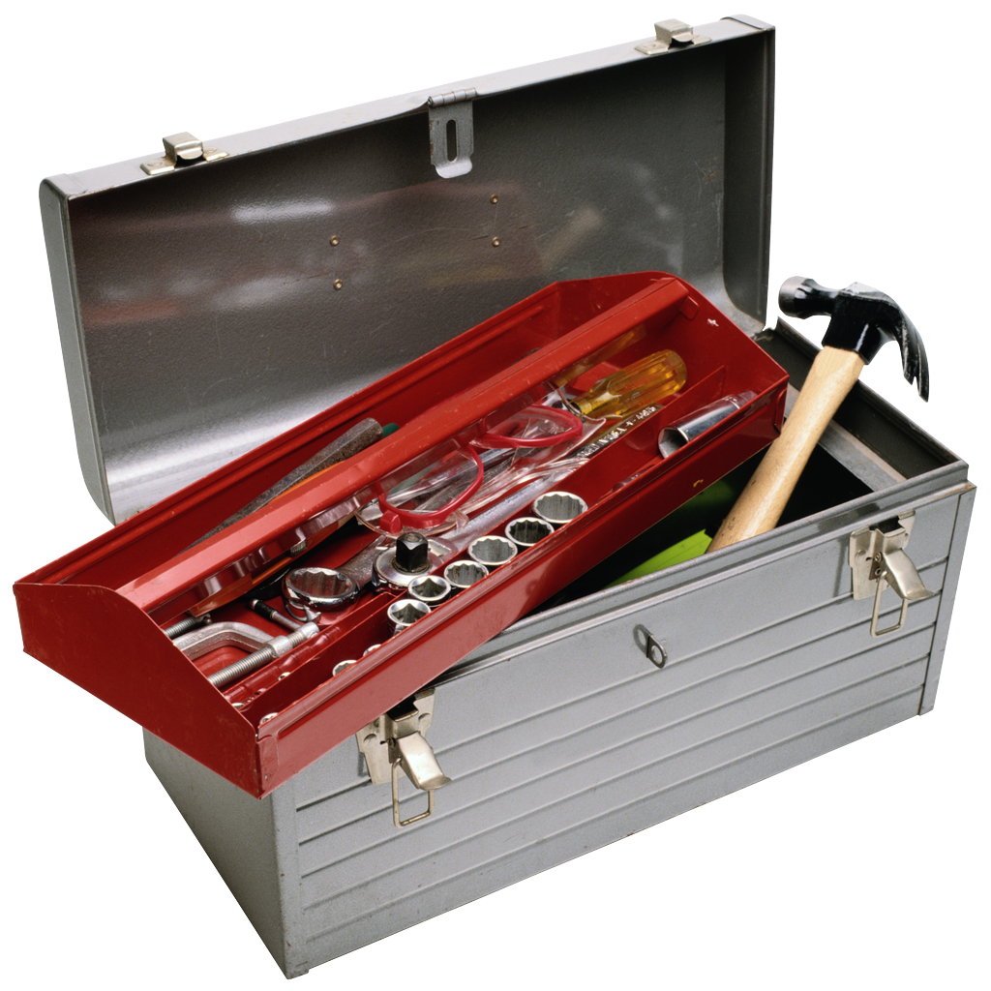
Other Pediatric Toolkit Essentials

Slide 28
Gut health : Prebiotics
Prebiotic foods
Non-digestible fiber that promotes growth of probiotic bacteria
Brain
Psyllium Husk
Inulin
Legumes, fruits, whole grains
Probiotic foods
Lactobacillus and bifidobacterium
Feremented foods
Miso, Kefir, Kimchi, Tempeh, Yogurt, Sauerkraut
Taylor, 2017a

Slide 29
Gut health: Caminatives
Help to ease bloating and gas
Many are culinary spices with fragrant aroma
Caution for people with GERD
Examples
Fennel
Anise
Dill
Cinnamon
Peppermint
Incorporate into spice mixes for food
Taylor, 2017a

Slide 30
URI help: Sore throat
Salt water gargle
Mix salt with warm water
Gargle and spit
Reduces inflammation in throat that contributes to pain
Honey
1-2 tsp as needed for sore throat
Can also mix into tea
Taylor, 2017c

Slide 31
URI Help: Cough
Honey
1-2 tsp honey before bedtime for nighttime cough
Thyme
Thymol and carvacol, essential oils with anti-septic, anti-inflammatory and expectorant properties
4 tbsp fresh thyme in 1 cup hot water, steep 15 minutes, strain. Can add honey too
Aromatherapy steam
Pot of water to a boil, remove from head, sit for a few minutes, add 3-5 drops essential oil (eucalyptus or peppermint), put head 15-20 inches from bowel and cover head with a cloth and form a tent and breath
Taylor, 2017c

Slide 32
Conclusions
Some go-to botanicals for children are:
Chamomile: calm, relaxing, combination with fennel & lemon balm for colic, combined with pectin for diarrhea
Aloe Vera: topical application for burns
Calendula: topical applications for atopic dermatitis, diaper dermatitis, insect bites
Lemon balm: calming/sleep, gas/bloating, topical for HSV skin lesions
Peppermint: inhaled for cough, topical for headaches, enteric coated for IBS
Ginger: Gas, bloating, nausea, vomiting
Butterbur: allergies and migraine prophylaxis

Slide 33

Takeaways
Botanicals, just like any other medicines, can have both beneficial and harmful effects
Sometimes parents might perceive botanicals as natural and therefore “safe”
Botanicals for use in children must be selected carefully due to safety concerns
Having a toolkit of safe and effective botanicals may help improve the provider-patient relationship because there are additional treatment options for common conditions

Slide 34
References
Bone, K. & Mills, S. (2013). Principles and practices of phytotherapy (2nd ed.). Edinburgh: Elsevier.
De la Motte, S., Böse-O'Reilly, S., Heinisch, M., & Harrison, F. (1997). Double-blind comparison of an apple pectin-chamomile extract preparation with placebo in children with diarrhea. Arzneimittel-Forschung, 47(11), 1247-1249.
Dog, T. L. (2008). Smart talk on supplements and botanicals. Alternative & Complementary Therapies, 14(5), 227-230.
Ernst, E. (2003). Serious adverse effects of unconventional therapies for children and adolescents: a systematic review of recent evidence. European journal of pediatrics, 162(2), 72-80.
Fazio, S., Pouso, J., Dolinsky, D., Fernandez, A., Hernandez, M., Clavier, G., & Hecker, M. (2009). Tolerance, safety and efficacy of Hedera helix extract in inflammatory bronchial diseases under clinical practice conditions: a prospective, open, multicentre postmarketing study in 9657 patients. Phytomedicine, 16(1), 17-24.
Gardiner, P., & Low Dog, T. (2010). A pediatric perspective on herbals and supplements. In T. Culbert & K. Olness (Eds.), Integrative pediatrics (217-233). New York, NY: Oxford University Press.
Kline, R. M., Kline, J. J., Di Palma, J., & Barbero, G. J. (2001). Enteric-coated, pH-dependent peppermint oil capsules for the treatment of irritable bowel syndrome in children. The Journal of pediatrics, 138(1), 125-128.

Slide 35
References cont.
Maenthaisong, R., Chaiyakunapruk, N., Niruntraporn, S., & Kongkaew, C. (2007). The efficacy of aloe vera used for burn wound healing: a systematic review. burns, 33(6), 713-718.
Panahi, Y., Sharif, M. R., Sharif, A., Beiraghdar, F., Zahiri, Z., Amirchoopani, G., ... & Sahebkar, A. (2012). A randomized comparative trial on the therapeutic efficacy of topical aloe vera and Calendula officinalis on diaper dermatitis in children. The Scientific World Journal, 2012.
Pothmann, R., & Danesch, U. (2005). Migraine prevention in children and adolescents: results of an open study with a special butterbur root extract. Headache: The Journal of Head and Face Pain, 45(3), 196-203.
Savino, F., Cresi, F., Castagno, E., Silvestro, L., & Oggero, R. (2005). A randomized double‐blind placebo‐controlled trial of a standardized extract of Matricariae recutita, Foeniculum vulgare and Melissa officinalis (ColiMil®) in the treatment of breastfed colicky infants. Phytotherapy research, 19(4), 335-340.
Taylor, A. (2017a) Botanicals for gastrointestinal disease [PDF document]. Retrieved from Canvas site: https://drive.google.com/file/d/0B2onVuxwFhvAWUVmWGxEeWlPdVU/view
Taylor, A. (2017b). Botanicals for mental wellbeing and stress. [PDF document]. Retrieved from Canvas site: https://drive.google.com/file/d/0B2onVuxwFhvALVp0YUQ4Tmp0MW8/view
Taylor, A. (2017c). Botanicals for respiratory system [PDF document]. Retrieved from Canvas site: https://drive.google.com/file/d/0B2onVuxwFhvAVzVGSXhZWHFMY0k/view

